Slide 1
Pronounce

Slide 2





Sangeetha
TEAM PRONOUNCE
Ravi
Gopinadh
Roshin
Shwetha

Slide 3

Why Pronounce
Pronouncing someone's name correctly isn't just a common courtesy. It's far more than just the syllables that come out of someone's mouth. It's an important effort to create an inclusive society, a way to emphasize safety and belonging.
Let’s build more inclusive and safe society through Pronounce!
A person's name is to him or her the sweetest and most important sound in any language.
Name can tell the world a lot about one’s identity, as well as one’s cultural and familial background.
Making an effort to pronounce an person's name serves as a sign of respect .
It's important to respectfully ask someone about the correct pronunciation of their name.

Slide 4
How Pronounce
Pronounce provides complete ecosystem to enable name pronunciation across different channels.
High Performing Rest Service (Java)
Admin Web Portal (Angular)
Mobile App (Android & iOS)

Slide 5
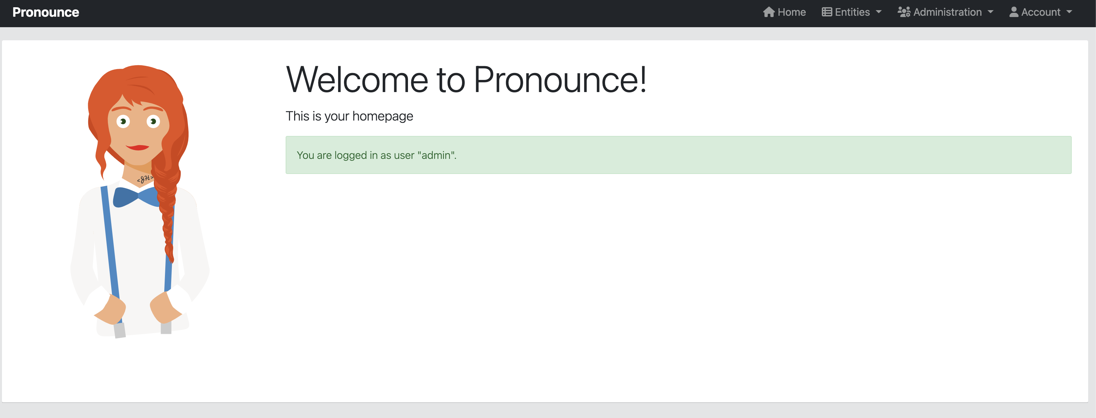
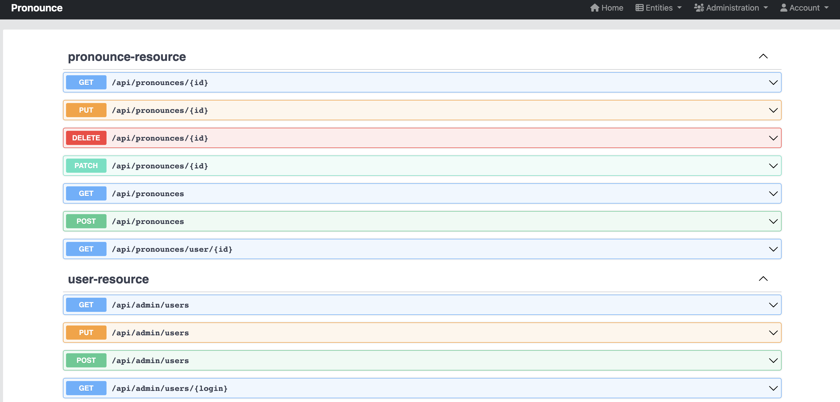
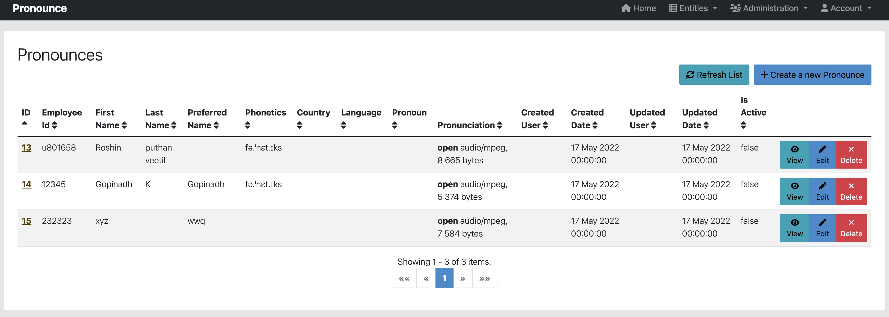
Admin Web App

Slide 6
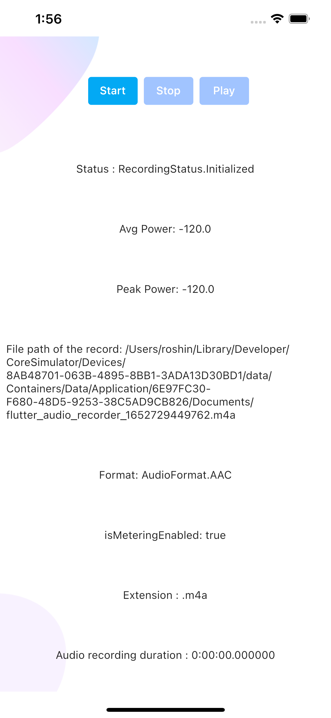
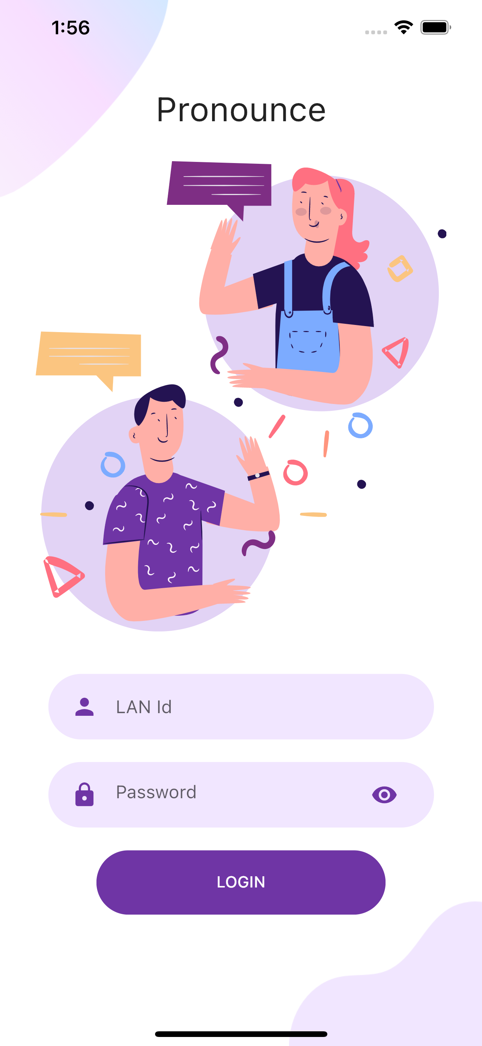
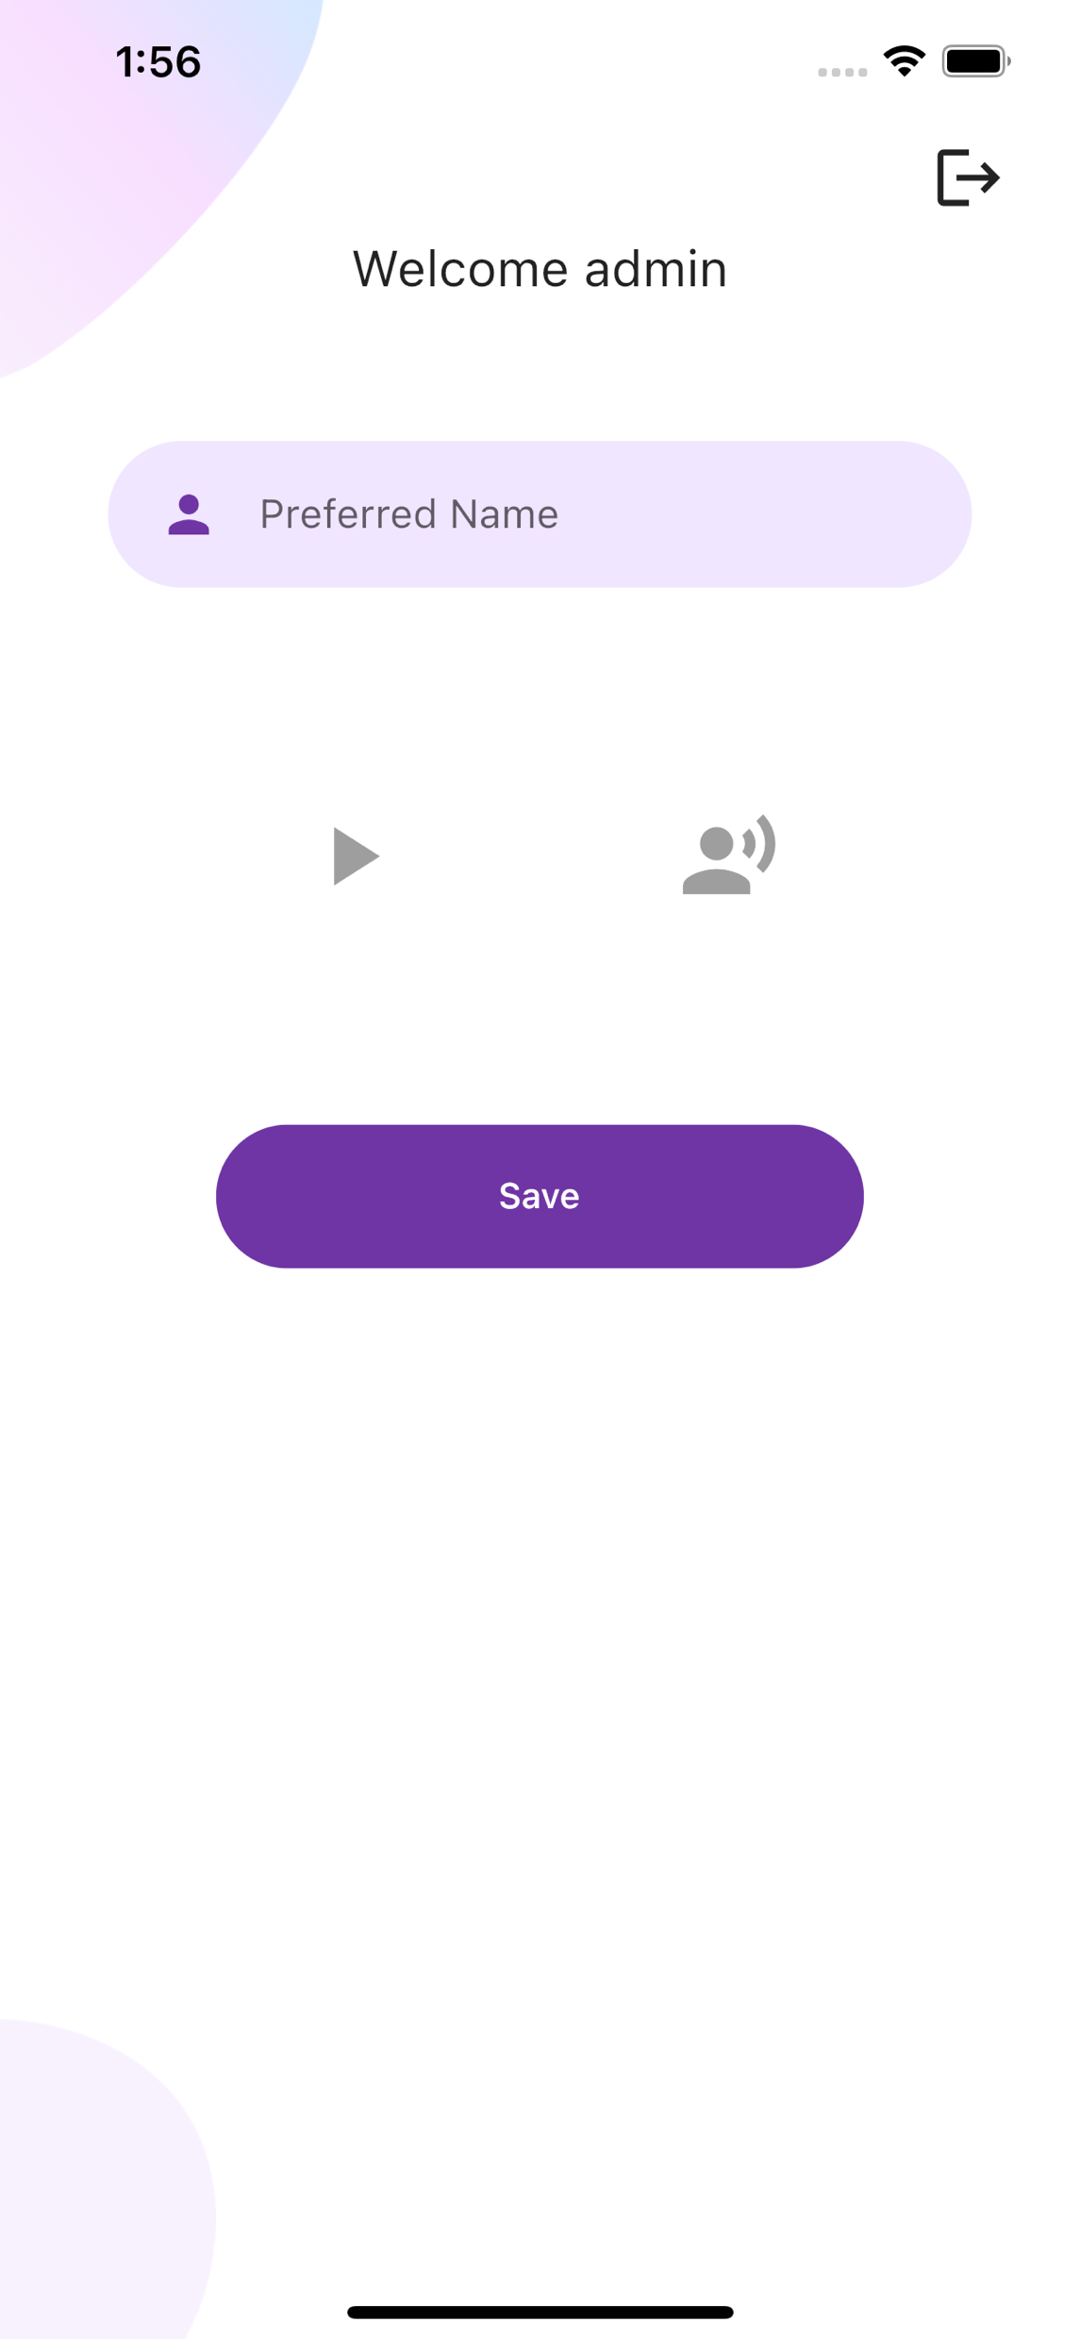
Mobile App

Slide 7
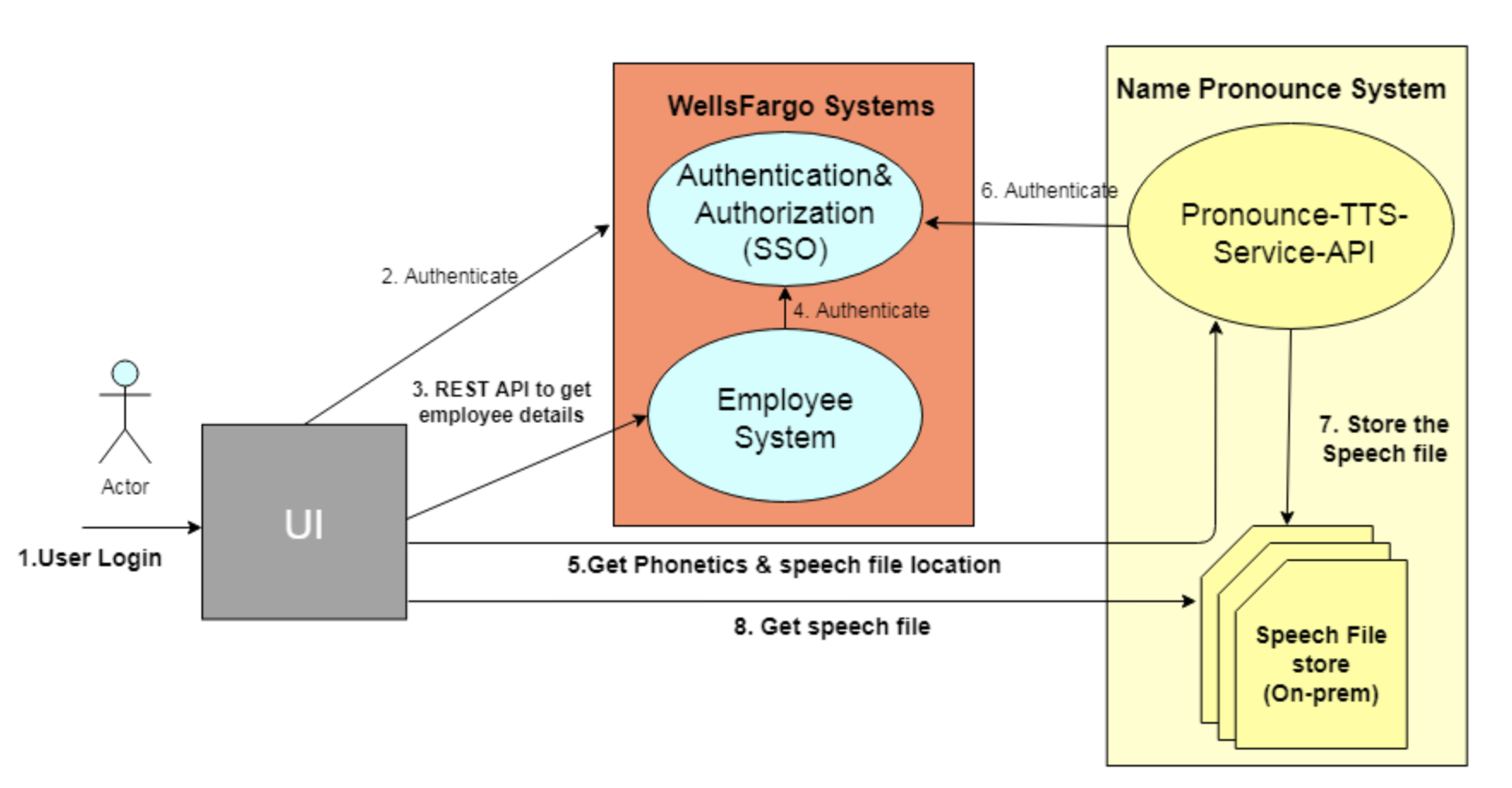
Pronounce System

Slide 8
Use cases
User Interface where the employee ID is given along with first name ,last name and preferred name with Country opted ,which creates the phonetics and standard pronunciation of first name +last name (if preferred name is empty) or preferred name if provided)) is generated and stores in the database.
User Interface which takes the customised audio playback and overrides the audio data stored in db.
User Interface which takes the employee ID information of the fellow employee which returns the standard /customised name pronunciation audio playback and phonetic information.

Slide 9
Assumptions made
There is a main employee table where we have only read access in which the employee details are stored. Our table loads the employee first name ,last name ,employee Id information from the master table to our app specific table .These fields are non modifiable.
By default the phonetic and sound track is produced from the first name +last name combination.
If user adds preferred name data ,then the phonetic and sound track will be recreated with these two information.

Slide 10
Roles in the System
Admin - who has complete privilege to view all user information and performs add/delete or update user related information .
User -who has limited privilege and can view his own information and update the information. User can just access the phonetic and audio information of other employees but cant update an information of others. User Interface which takes the employee ID information of the fellow employee which returns the standard /customised name pronunciation audio playback and phonetic information

Slide 11
Sequence of Steps :
UI will make a call to SSO to get valid security token, first name, last name, and uid.
A GET method is used to connect the 'Name Pronounce System' for getting the phonetics, and creating the speech file in the speech file store based on the preferred name, or combination of first name and last name.
The sample response would be in below format for a uid=u99999, firstname=Paul and lastName=John,
{
"fileLocation": "http://35.10.34.12:5000/u99999-Paul John.mp3",
"phonetics": "pɔl ʤɑn"
}

Slide 12
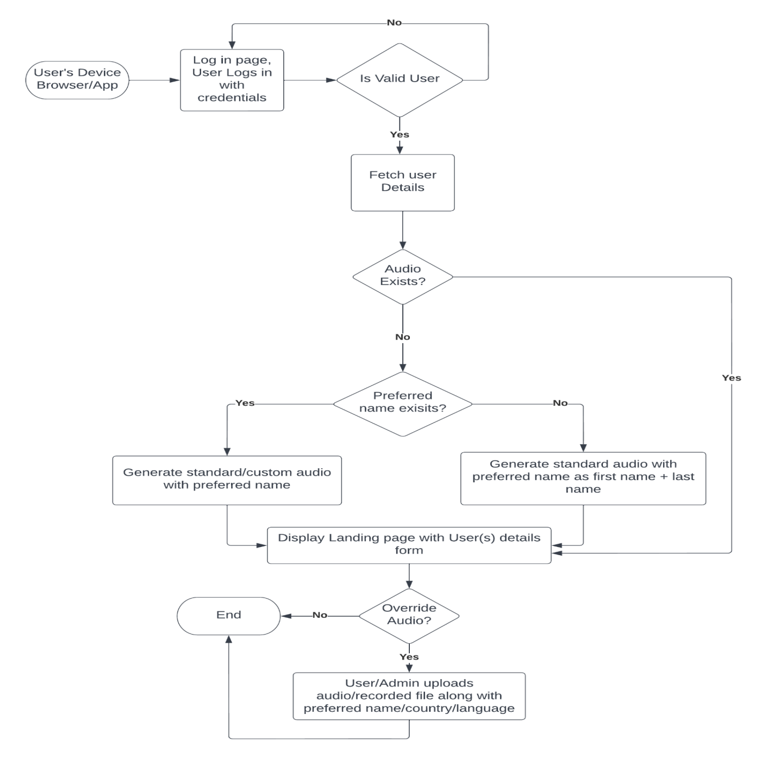
Flow Diaram

Slide 13
Pricing of GCP TTS:
Text to Speech is priced based on the number of characters sent to the service to be synthesized into audio each month.
Charged automatically, if usage exceeds the number of free characters allowed per month ( i.e. Including spaces, SSML tags ,newlines).
A waveNet generates speech that sounds more natural than other test-to-speech systems. It synthesizes speech with more human-like emphasis and inflection on syllables ,phonemes and words.
Feature | Free per month | Price after free usage limit is reached
Standard (non –Wavenet ) voices | 0-4 million characters | $0.000004 USD per character($4.00 USD per 1 million chars)
Wavenet Voices | 0-1 million characters | $0.000016 USD per character($16.00 USD per 1 million chars)

Slide 14
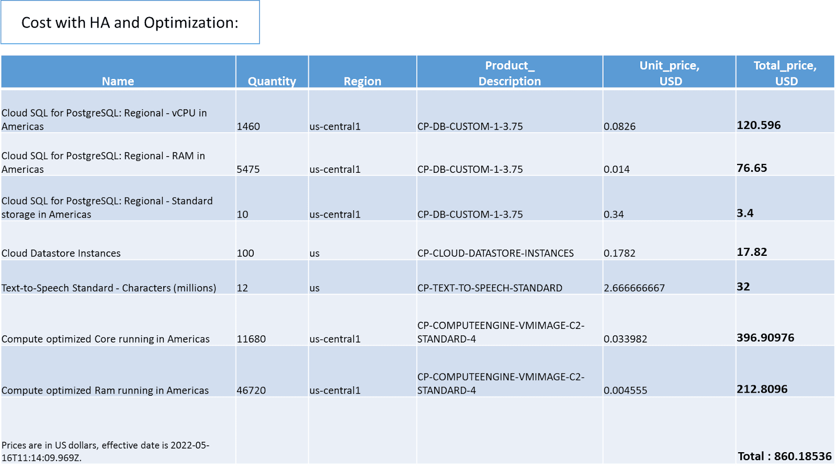

Slide 15
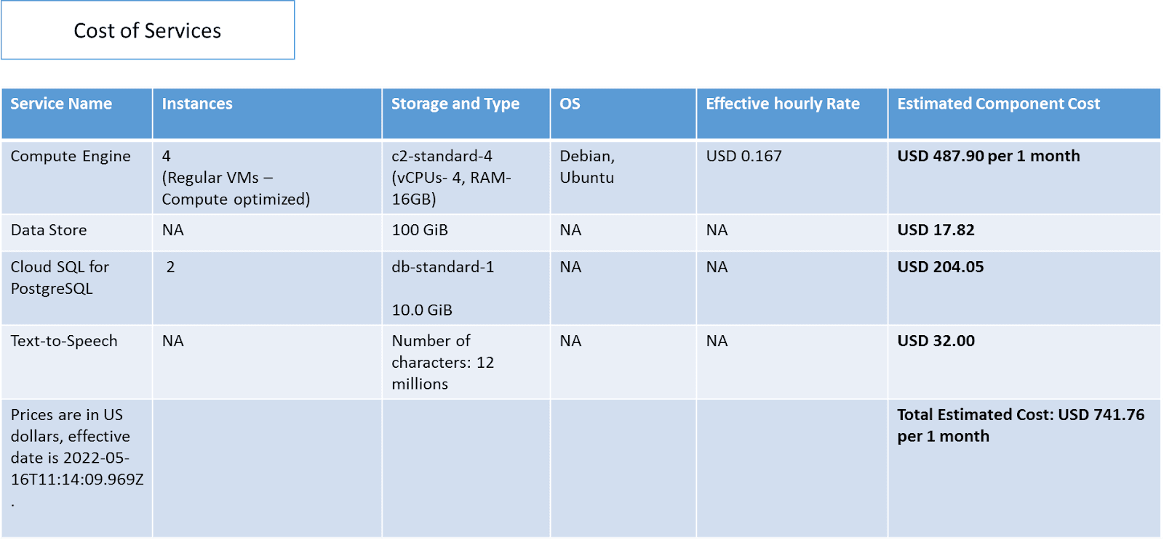

Slide 16
THANK YOU

